Slide 1



Slide 2




By Bonface Mamboleo
01

Slide 3
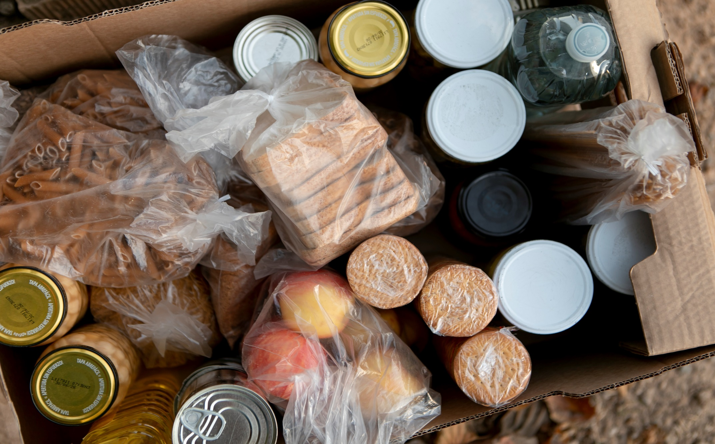


THE PROBLEM
Kenya wastes over 30% of edible food yearly.
Over 14 million Kenyans face food insecurity.
Lack of coordination between food donors and recipients.
Logistical and awareness barriers worsen food waste.
10
2

Slide 4



Our Solution
ChakulaConnect is a mobile-first platform that:
Connects food donors (homes, farms, restaurants) with recipients (NGOs, shelters).
Facilitates logistics and pickups in real time.
Tracks food impact and generates transparency.
06
3

Slide 5
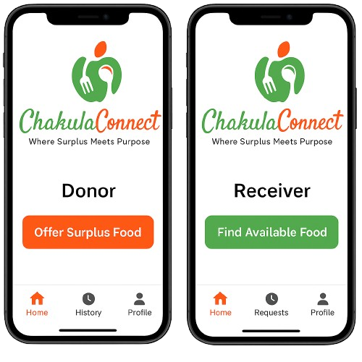
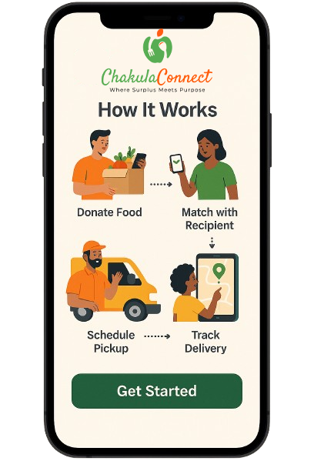
Product
How it Works
1. Donors upload surplus food items.
2. Recipients request available food.
3. Platform matches them based on location and urgency.
4. Drivers/volunteers are notified for pickup and delivery.
4

Slide 6




Target Market
3 out 5
Urban dwellers in Kenya who are willing to donate excess food if given a convenient platform.
87%
Of food establishments report throwing away edible food weekly, especially in cities like Nairobi and Mombasa.
15 million
Kenyans face food insecurity annually, representing a massive market need ChakulaConnect aims to bridge.
5

Slide 7

Market Size
Kenya has a population of around 54 million people. Out of this:
Urban Population – ~31% (~16.7 million)
Target Segment:
8M+ potential donors: restaurants, hotels, households, institutions.
3M+ tech-savvy individuals willing to use mobile platforms for food donation.
People Facing Food Insecurity – ~15 million
These are the primary beneficiaries, including slum dwellers, refugees, and low-income communities.
Food Businesses – Over 40,000 registered food-related businesses
Supermarkets, groceries, fast food chains, restaurants – a huge pool of potential recurring donors.

Slide 8





Competitors
VS.
ChakulaConnect
Food Banking Kenya
To Good To Go
Share The Meal
7

Slide 9

Competitive Advantage
1. Dual-Sided App (Donor & Receiver)
One platform, two perspectives: Individuals, supermarkets, and restaurants donate — charities, shelters, and community centers receive.
Most alternatives focus on just redistribution logistics, not engagement.
2. Real-Time Matching
Instant matching between food donors and nearby receivers using location data.
Reduces waste by speeding up the collection and redistribution process.
3. Transparent Tracking System
Full visibility on donation journey: from surplus to recipient.
Builds trust and accountability — a big plus for corporate donors and NGOs.
4. Community Empowerment & Volunteer Integration
Involves communities through volunteer drivers and local outreach.
Adds a human connection layer that most tech platforms overlook.
5. Sustainability + Purpose-Driven Branding
“Where Surplus Meets Purpose” — not just reducing waste, but serving humanity.
Strong emotional appeal that resonates with modern conscious users and funders.
6. Gamification & Impact Metrics (Coming Soon)
Users can track their impact, earn badges, and share their positive footprint.
This creates engagement beyond just transactions.

Slide 10

Project Traction
Tasks
Month 1
Month 2
Month 3
Month 4
Month 5
Project Planning & Research
Branding & Visual Identity
UI/UX Design (Wireframe)
Backend Architecture Design
Prototype Development
Partner/NGO onboarding
MVP Launching & User Testing
9

Slide 11


Business Model
1. Subscription Plans Large food donors (restaurants, supermarkets, event organizers) pay monthly or annually for access to dashboards, impact analytics, priority support.
2. NGO Premium Tools NGOs pay a small monthly fee for delivery tracking, inventory management, volunteer coordination.
3. Corporate Sponsorships Brands sponsor donation campaigns and gain visibility on the platform (great for CSR).
4. Data & Impact Reports Anonymized data is sold to researchers, government agencies, or international organizations.
5. Grants & Impact Investments Funding from social development organizations (UN, WFP, government bodies, etc.).
6. Delivery Coordination Fees (Optional) A small fee per successful food donation delivery if ChakulaConnect helps coordinate transport.
10

Slide 12

Revenue
Monthly Revenue Breakdown (Sample for Nairobi)
Estimated Monthly Operating Costs
Revenue Source | Units | Rate | Total
Subscribing Businesses | 50 | KES 2,000 | KES 100,000
NGOs on Premium | 20 | KES 1,000 | KES 20,000
Corporate Sponsors | 2 | KES 25,000 | KES 50,000
Delivery Fees (Optional) | 500 deliveries | KES 20 | KES 10,000
Total Revenue |  |  | KES 180,000
Expense Category | Monthly Cost
Server & Cloud Hosting | KES 10,000
Staff Salaries (Support & Dev) | KES 80,000
Marketing & Community Engagement | KES 15,000
NGO Vetting & Legal Compliance | KES 5,000
Logistics Coordination | KES 10,000
Total Costs | KES 120,000
Profit & Profit Margin
Net Monthly Profit: KES 180,000 – KES 120,000 = KES 60,000
Profit Margin Calculation: (60,000 / 180,000) × 100 = 33.3%
With scale and optimization, margins can grow significantly.
11

Slide 13


Go To Market
1. Target Audience
Food Donors: Restaurants, supermarkets, food producers, corporates
NGOs & Distribution Centers: Orphanages, shelters, food banks
Beneficiaries: Local communities, individuals in need
2. Key Approaches
Partnerships & Collaborations:
Partner with NGOs, corporate sponsors, and government agencies.
Digital Marketing:
Social media campaigns, influencer marketing, and targeted ads.
Offline Outreach:
Community events, corporate CSR engagement, and media outreach.
Content Marketing:
Blogs, case studies, impact reports, and video storytelling.
Incentive Programs:
Referral bonuses, discounts for early adopters.
3. Channels
Social Media Platforms: Facebook, Instagram, LinkedIn
Website: User-friendly, mobile optimized for easy donations and tracking
SMS/WhatsApp Campaigns: Direct engagement for food donations and delivery coordination.
4. Local and Targeted Campaigns
Geo-targeted ads and mobile marketing to reach specific areas with high food insecurity.
12

Slide 14

Social Impact
Reducing Food Waste
Donations from businesses- reduce food waste by redirecting surplus, unsold, or near-expiry food to those who need it.
Environmentally sustainable-reducing the environmental burden caused by discarded food, which decomposes and releases methane, a harmful greenhouse gas.
Addressing Food Insecurity
Empowering NGOs and food banks: ChakulaConnect connects food donors with local NGOs, community centers, and shelters that directly provide food to vulnerable populations, including low-income families, orphans, and the homeless.
Improving access to nutrition: It ensures that those in need have better access to nutritious food, helping improve public health and reducing malnutrition.
Strengthening Community Networks
Building community resilience: By creating a platform that fosters connections between donors and NGOs, ChakulaConnect strengthens community networks that support one another in times of need.
Encouraging corporate responsibility: It encourages businesses to play an active role in social welfare by providing an easy and efficient way to donate surplus food.
Economic Benefits
Supporting local economies: By helping local businesses donate excess food, ChakulaConnect creates a win-win situation where businesses reduce waste costs, NGOs gain more resources, and communities thrive.
Job creation: As the platform grows, it can create jobs in the logistics, tech, and nonprofit sectors.
Raising Awareness & Advocacy
Promoting food waste awareness: Through its campaigns, ChakulaConnect educates the public and businesses about the importance of reducing food waste and contributing to social good.
Social change: By focusing on food insecurity and waste reduction, ChakulaConnect is a part of a broader movement towards social and environmental responsibility.
In essence, ChakulaConnect is not just a food donation platform, but a key player in promoting sustainability, community welfare, and social equity.
13

Slide 15


Our Ask
We Are Seeking:
Ksh 1 Million (~USD 7,000) in seed funding + Strategic partnerships with food donors, NGOs, logistics providers, and tech collaborators.
How We Will Use the Ksh 1M Budget:
Category | Amount (KSh) | Purpose
Platform MVP Development | 400,000 | Basic web/app build (for donors + NGOs), testing
Marketing & Branding | 200,000 | Logo, social media, launch awareness, materials
Operations & Piloting | 200,000 | Food collection & pilot delivery in select areas
Legal & Admin Setup | 100,000 | Registration, food safety compliance, agreements
Monitoring & Support | 100,000 | Feedback collection, analytics, basic staff support
We’re Looking for Partners In:
Food Donors – Restaurants, hotels, supermarkets, and farms
NGOs – For food redistribution and last-mile reach
Logistics Providers – To assist with affordable or sponsored deliveries
Tech Experts – To collaborate on MVP and future development
Media & Influencers – To help create visibility and drive adoption
14

Slide 16





Team Members
BONFACE MAMBOLEO
CHANTELLE AMAIZAH
ANDREW OCHIENG
JOSEPH MUSINGA
Founder, Software Developer & Tech Lead
Operation & Logistics Lead
Marketing & Community Engagement Lead
Field Coordinator
15

Slide 17




CALL TO ACTION
Be Part of the Change Support ChakulaConnect in transforming surplus into sustenance.
✅ Ways to Get Involved
Partner with us to roll out pilot programs
Sponsor a logistics hub or driver fleet
Fund technology and community awareness campaigns
Collaborate as a corporate CSR or impact donor
📩 Let’s Talk Email: mamboleobonface001@gmail.com Phone: [+254 796682070/+254 748189181]
16

